Slide 1
The Greedy Design Technique-2
Lecture-5: Huffman Coding & Activity Scheduling
Md. Golam Shahriar,
Lecturer, Dept. of CSE, VU

Slide 2
Data Compression
Data compression is a field of study that studies and exploits the properties present in the data to develop algorithm for compressing them to minimize the required storage space for storing them.
Compression can be either lossless or lossy.
In lossless compression, no information is lost thus ideal for text compressing.
In lossy compression, the limitations of human perceptual ability is exploited to compress data and tolerate some loss to such an extend that will not be noticed. This approach usually maximizes the variance in data. Ideal for signal compression.

Slide 3
The Huffman Coding Algorithm.
This is a very effective lossless data compression algorithm devised by David Huffman for compressing text data by using what is called variable length coding.
The algorithm assumes that the data is given as a sequence of characters with the associated frequency of occurrence of each character. The frequency usually depends on the language. For example the most frequently occurred character in English is ‘E’.
The Huffman algorithm works in a greedy way. It assigns lowest number of bits to most frequent characters and highest to least frequent thus reducing the number of bits required.

Slide 4
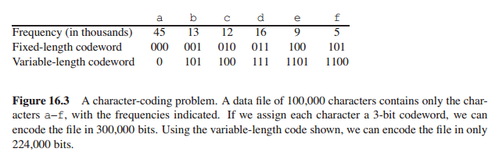
A Character Coding Problem

Slide 5
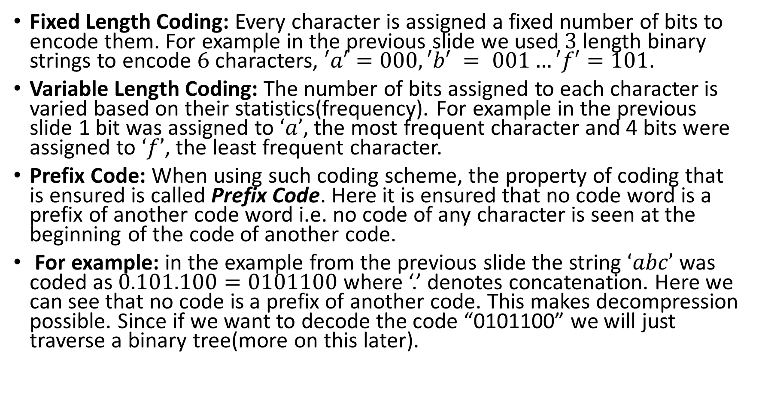
Some Terminologies
Fixed Length Coding: Every character is assigned a fixed number of bits to encode them. For example in the previous slide we used $3$ length binary strings to encode $6$ characters, $′a′=000, ′b′ = 001…′f′=101$.
Variable Length Coding: The number of bits assigned to each character is varied based on their statistics(frequency). For example in the previous slide 1 bit was assigned to $‘a’$, the most frequent character and 4 bits were assigned to $‘f’$, the least frequent character.
Prefix Code: When using such coding scheme, the property of coding that is ensured is called Prefix Code. Here it is ensured that no code word is a prefix of another code word i.e. no code of any character is seen at the beginning of the code of another code.
For example: in the example from the previous slide the string $‘abc’$ was coded as $0.101.100=0101100$ where ‘.’ denotes concatenation. Here we can see that no code is a prefix of another code. This makes decompression possible. Since if we want to decode the code “0101100” we will just traverse a binary tree(more on this later).

Slide 6
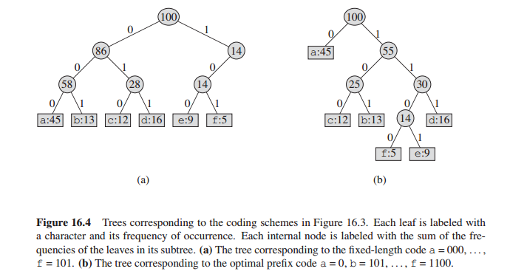
The Fixed vs Variable(Prefix) Coding Tree

Slide 7

Variable vs. Fixed Length Coding
From slide no. 4, fixed length coding would yield a total number of 300,000 bits as compared to variable length coding which would yield:
$\left(45×1+13×3+12×3+16×3+9×4+5×4\right)×1000=224,000$ bits

Slide 8
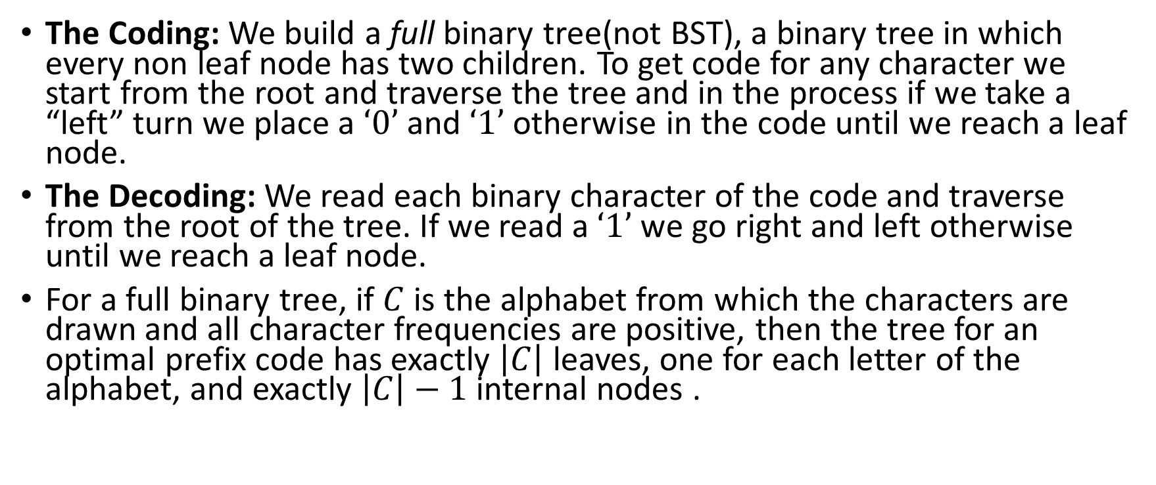
The General Approach to Coding and Decoding.
The Coding: We build a full binary tree(not BST), a binary tree in which every non leaf node has two children. To get code for any character we start from the root and traverse the tree and in the process if we take a “left” turn we place a $‘0’$ and $‘1’$ otherwise in the code until we reach a leaf node.
The Decoding: We read each binary character of the code and traverse from the root of the tree. If we read a $‘1’$ we go right and left otherwise until we reach a leaf node.
For a full binary tree, if $C$ is the alphabet from which the characters are drawn and all character frequencies are positive, then the tree for an optimal prefix code has exactly $\left|C\right|$ leaves, one for each letter of the alphabet, and exactly $\left|C\right|−1$ internal nodes .

Slide 9
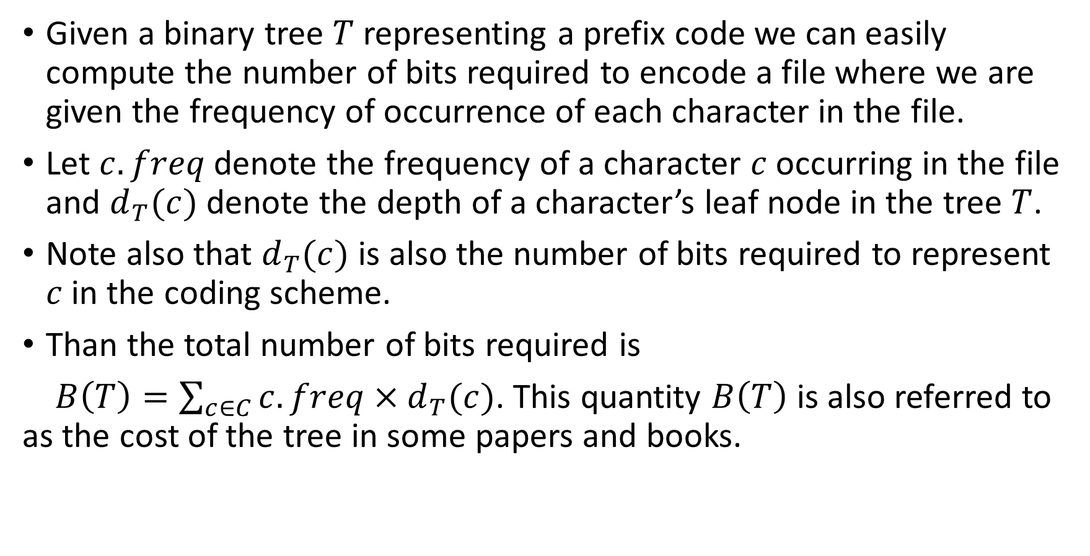
Number of Bits Required.
Given a binary tree $T$representing a prefix code we can easily compute the number of bits required to encode a file where we are given the frequency of occurrence of each character in the file.
Let $c.freq$ denote the frequency of a character $c$occurring in the file and $d_{T}(c)$ denote the depth of a character’s leaf node in the tree $T$.
Note also that $d_{T}(c)$ is also the number of bits required to represent $c$in the coding scheme.
Than the total number of bits required is
$B\left(T\right)=\sum_{c∈C}{c.freq×d_{T}(c)}$. This quantity $B\left(T\right)$ is also referred to as the cost of the tree in some papers and books.

Slide 10
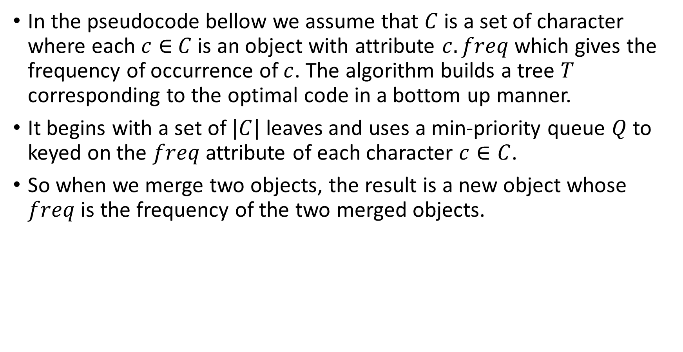
The Huffman Coding Algorithm
In the pseudocode bellow we assume that $C$ is a set of character where each $c∈$ $C$ is an object with attribute $c.freq$ which gives the frequency of occurrence of $c$. The algorithm builds a tree $T$ corresponding to the optimal code in a bottom up manner.
It begins with a set of $|C|$ leaves and uses a min-priority queue $Q$ to keyed on the $freq$ attribute of each character $c∈C$.
So when we merge two objects, the result is a new object whose $freq$ is the frequency of the two merged objects.

Slide 11
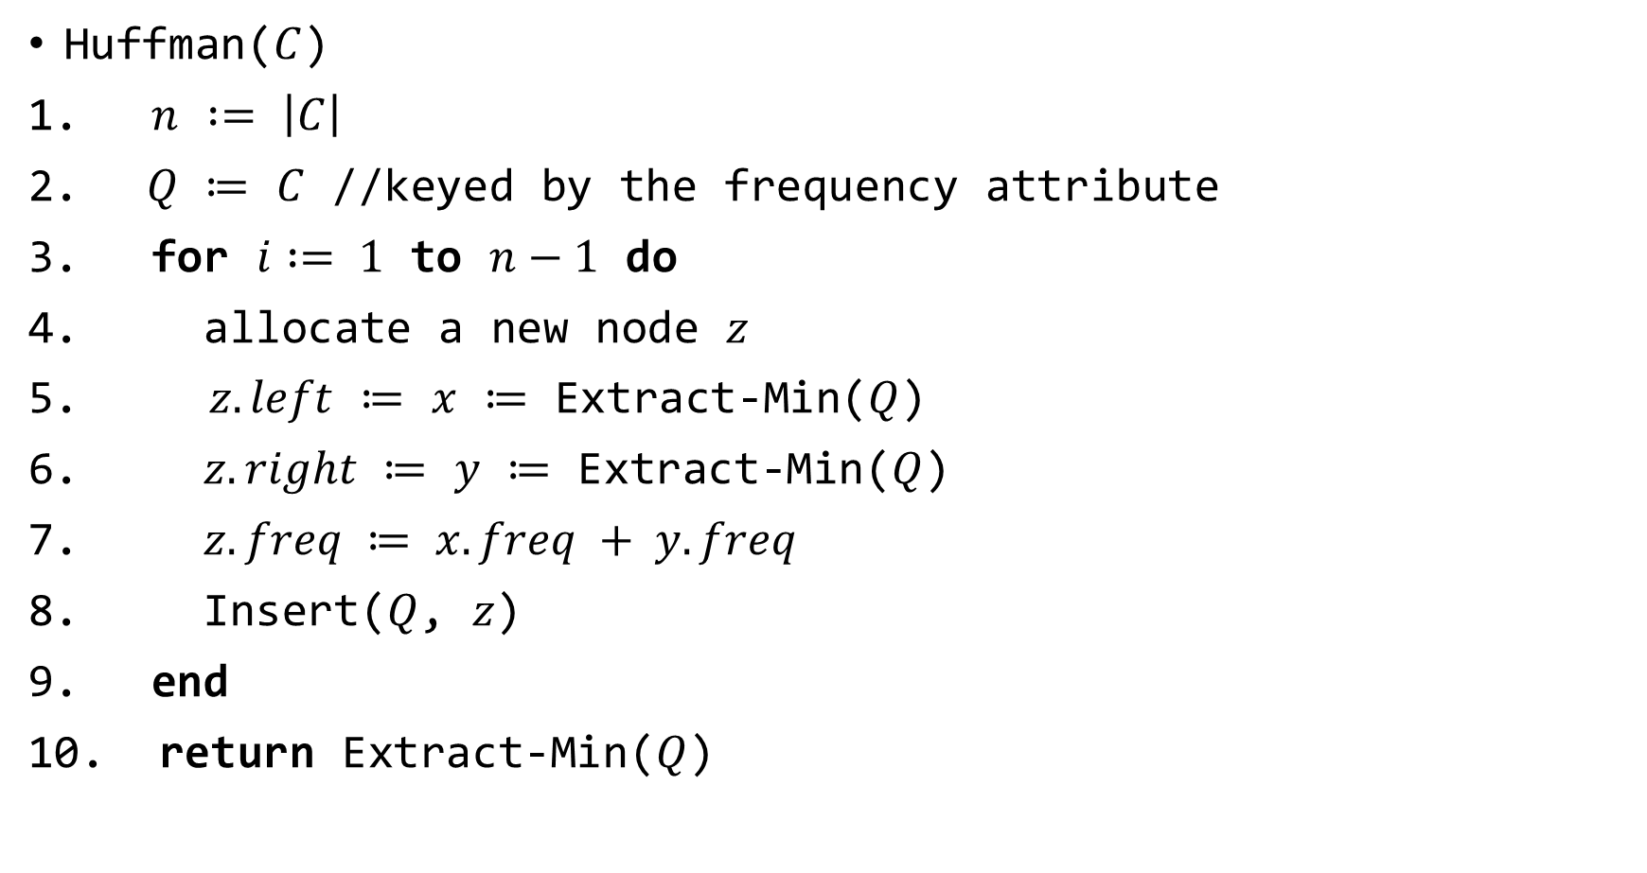
The Algorithm
Huffman($C$)
$n$ $:=$ $\left|C\right|$
$Q$ $≔$ $C$ //keyed by the frequency attribute
for $i := 1$ to $n−1$ do
allocate a new node $z$
$z.left$ $≔$ $x$ $≔$ Extract-Min($Q$)
$z.right$ $≔$ $y$ $≔$ Extract-Min($Q$)
$z.freq ≔ x.freq + y.freq$
Insert($Q$, $z$)
end
return Extract-Min($Q$)

Slide 12
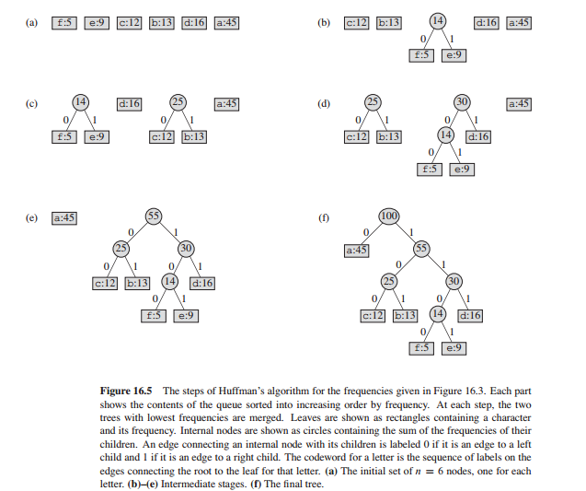

Slide 13
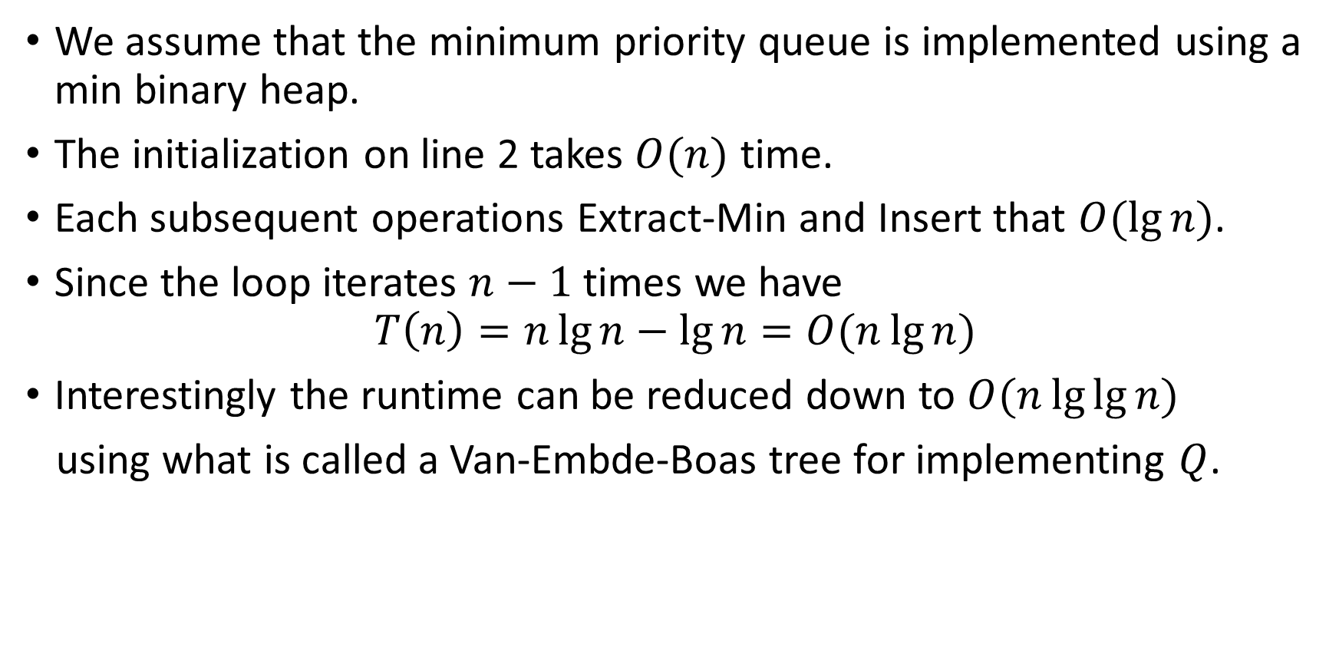
The Runtime of the Algorithm
We assume that the minimum priority queue is implemented using a min binary heap.
The initialization on line 2 takes $O(n)$ time.
Each subsequent operations Extract-Min and Insert that $O(\lg{n})$.
Since the loop iterates $n−1$times we have
$$T\left(n\right)=n\lg{n}−\lg{n}=O(n\lg{n})$$
Interestingly the runtime can be reduced down to $O(n\lg{\lg{n}})$
using what is called a Van-Embde-Boas tree for implementing $Q$.

Slide 14
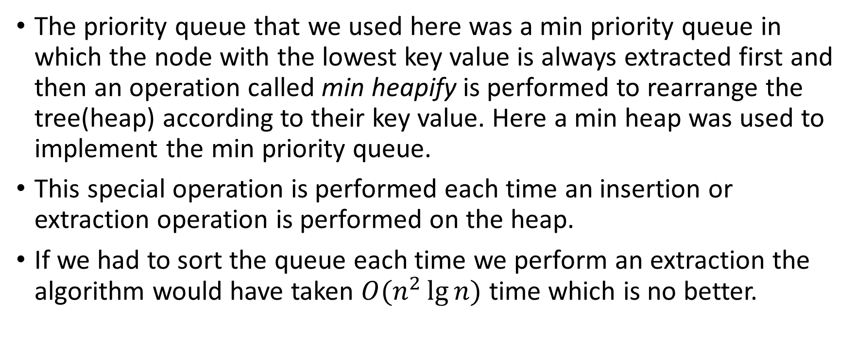
A Few Notes on The Priority Queue
The priority queue that we used here was a min priority queue in which the node with the lowest key value is always extracted first and then an operation called min heapify is performed to rearrange the tree(heap) according to their key value. Here a min heap was used to implement the min priority queue.
This special operation is performed each time an insertion or extraction operation is performed on the heap.
If we had to sort the queue each time we perform an extraction the algorithm would have taken $O(n^{2}\lg{n})$ time which is no better.

Slide 15
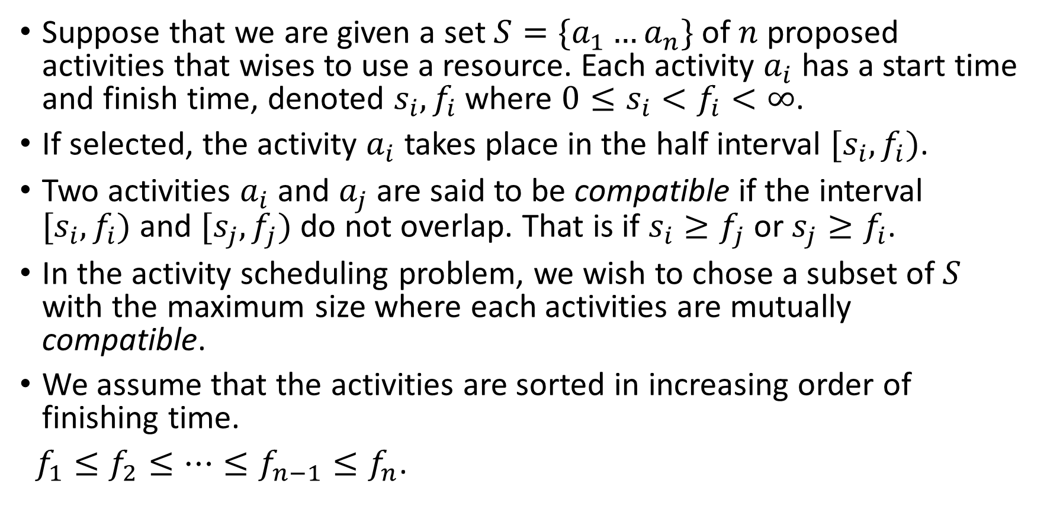
Activity Scheduling Problem
Suppose that we are given a set $S=\{a_{1}…a_{n}\}$ of $n$ proposed activities that wises to use a resource. Each activity $a_{i}$ has a start time and finish time, denoted $s_{i}, f_{i}$where $0≤s_{i}<f_{i}<∞$.
If selected, the activity $a_{i}$ takes place in the half interval $[s_{i},f_{i})$.
Two activities $a_{i}$ and $a_{j}$ are said to be compatible if the interval $[s_{i},f_{i})$ and $[s_{j},f_{j})$ do not overlap. That is if $s_{i}≥f_{j}$ or $s_{j}≥f_{i}$.
In the activity scheduling problem, we wish to chose a subset of $S$ with the maximum size where each activities are mutually compatible.
We assume that the activities are sorted in increasing order of finishing time.
$f_{1}≤f_{2}≤…≤f_{n−1}≤f_{n}$.

Slide 16

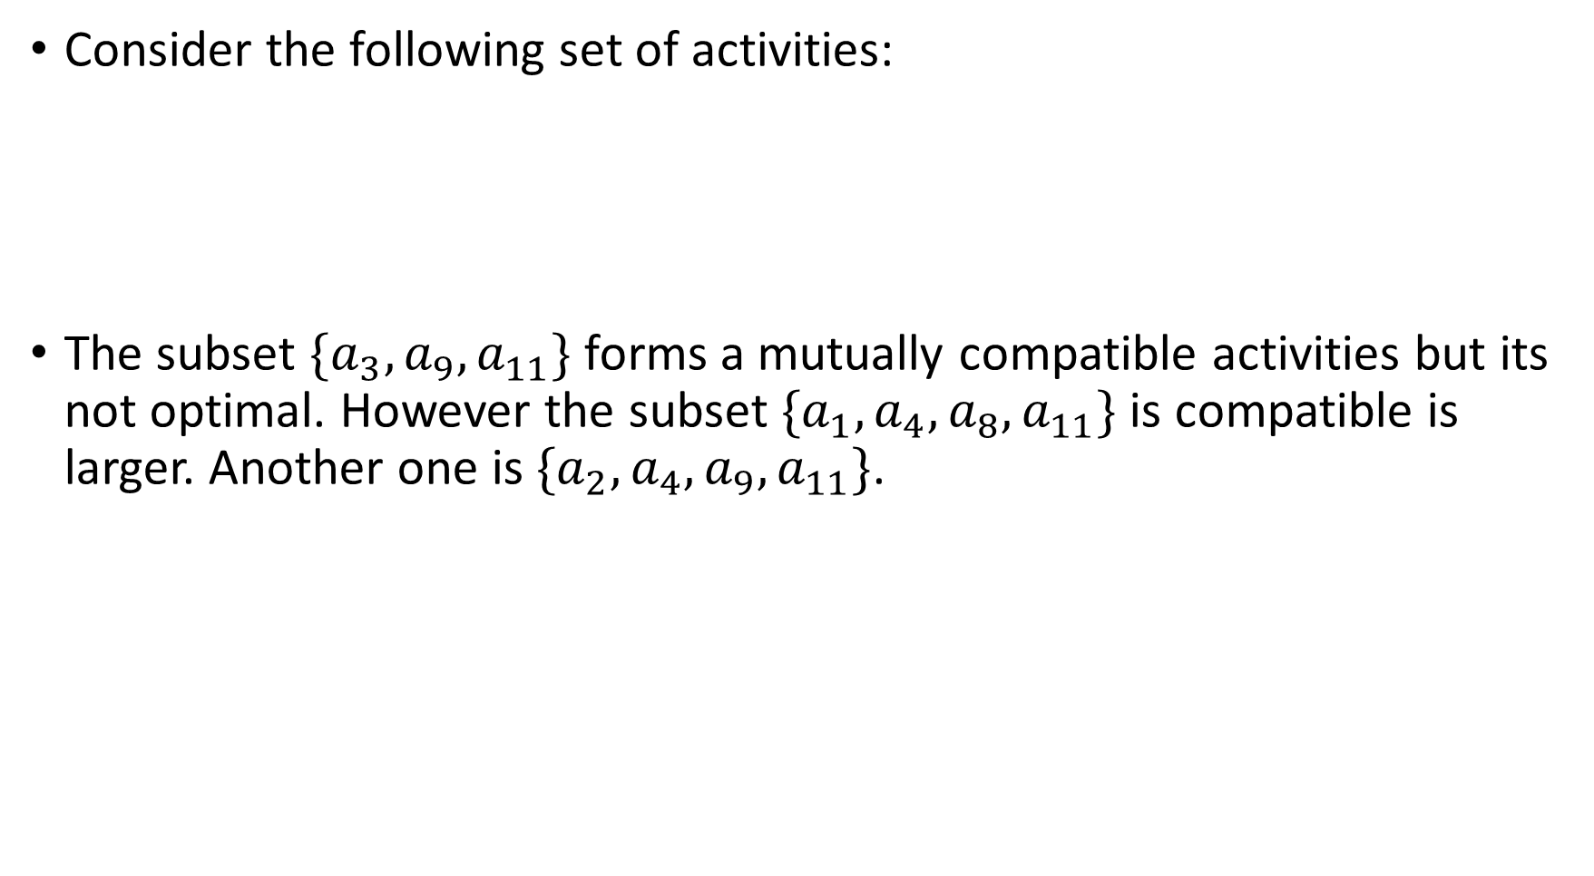
An Example
Consider the following set of activities:
The subset $\{a_{3}, a_{9},a_{11}\}$ forms a mutually compatible activities but its not optimal. However the subset $\{a_{1},a_{4},a_{8},a_{11}\}$ is compatible is larger. Another one is $\{a_{2},a_{4},a_{9},a_{11}\}$.

Slide 17
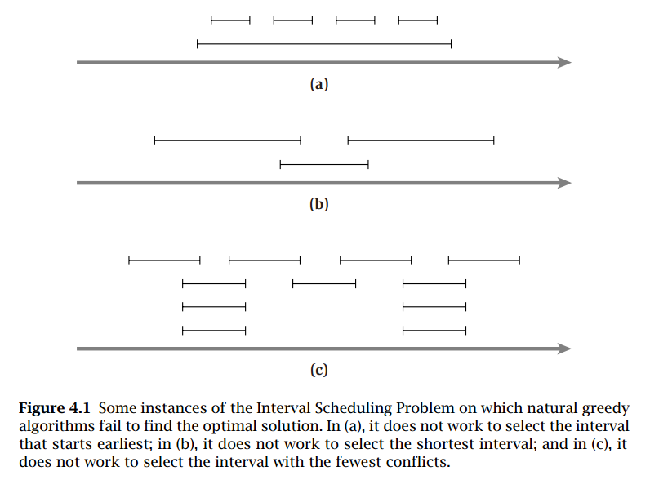
Some Sub-Optimal Greedy Strategy

Slide 18
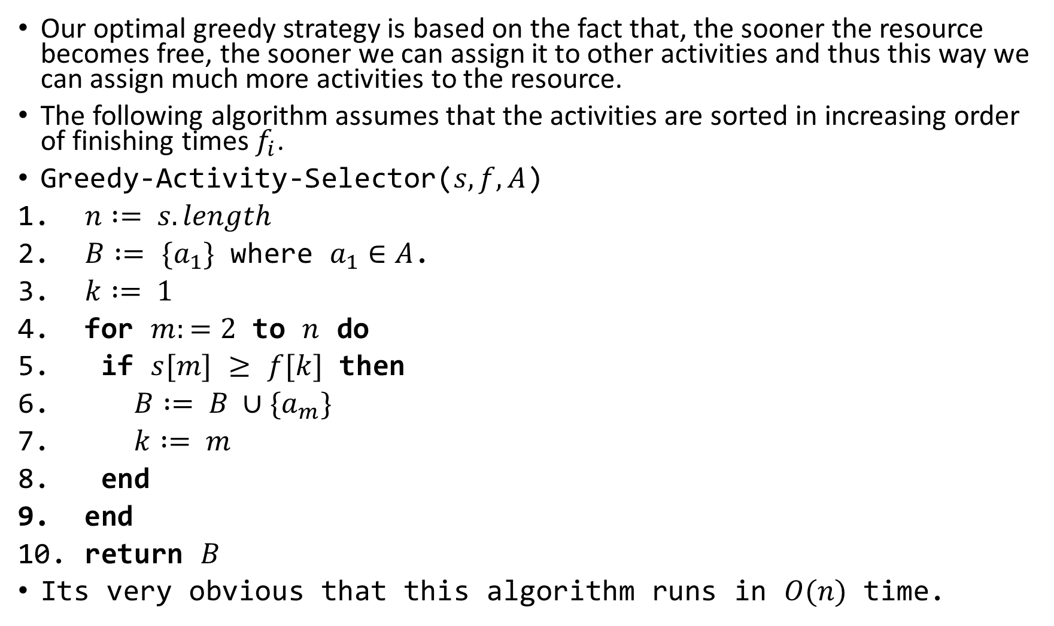
The Optimal Greedy Strategy
Our optimal greedy strategy is based on the fact that, the sooner the resource becomes free, the sooner we can assign it to other activities and thus this way we can assign much more activities to the resource.
The following algorithm assumes that the activities are sorted in increasing order of finishing times $f_{i}$.
Greedy-Activity-Selector($s, f, A$)
$n := s.length$
$B :=$ $\{a_{1}\}$ where $a_{1}∈A$.
$k := 1$
for $m:=2$ to $n$ do
if $s[m]$ $≥$ $f[k]$ then
$B := B ∪\{a_{m}\}$
$k := m$
end
end
return $B$
Its very obvious that this algorithm runs in $O(n)$ time.

Slide 19
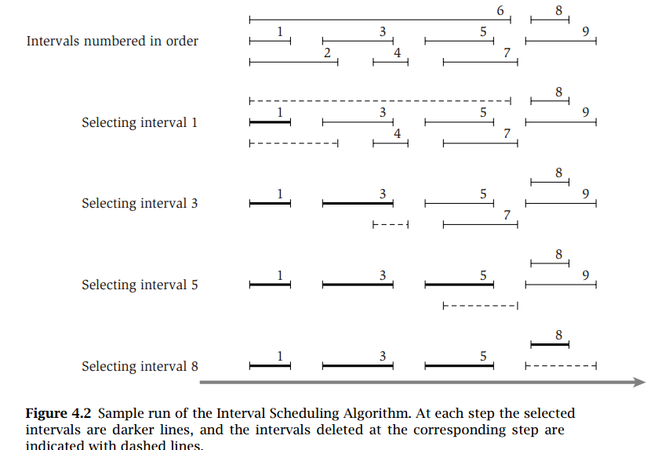

Slide 20
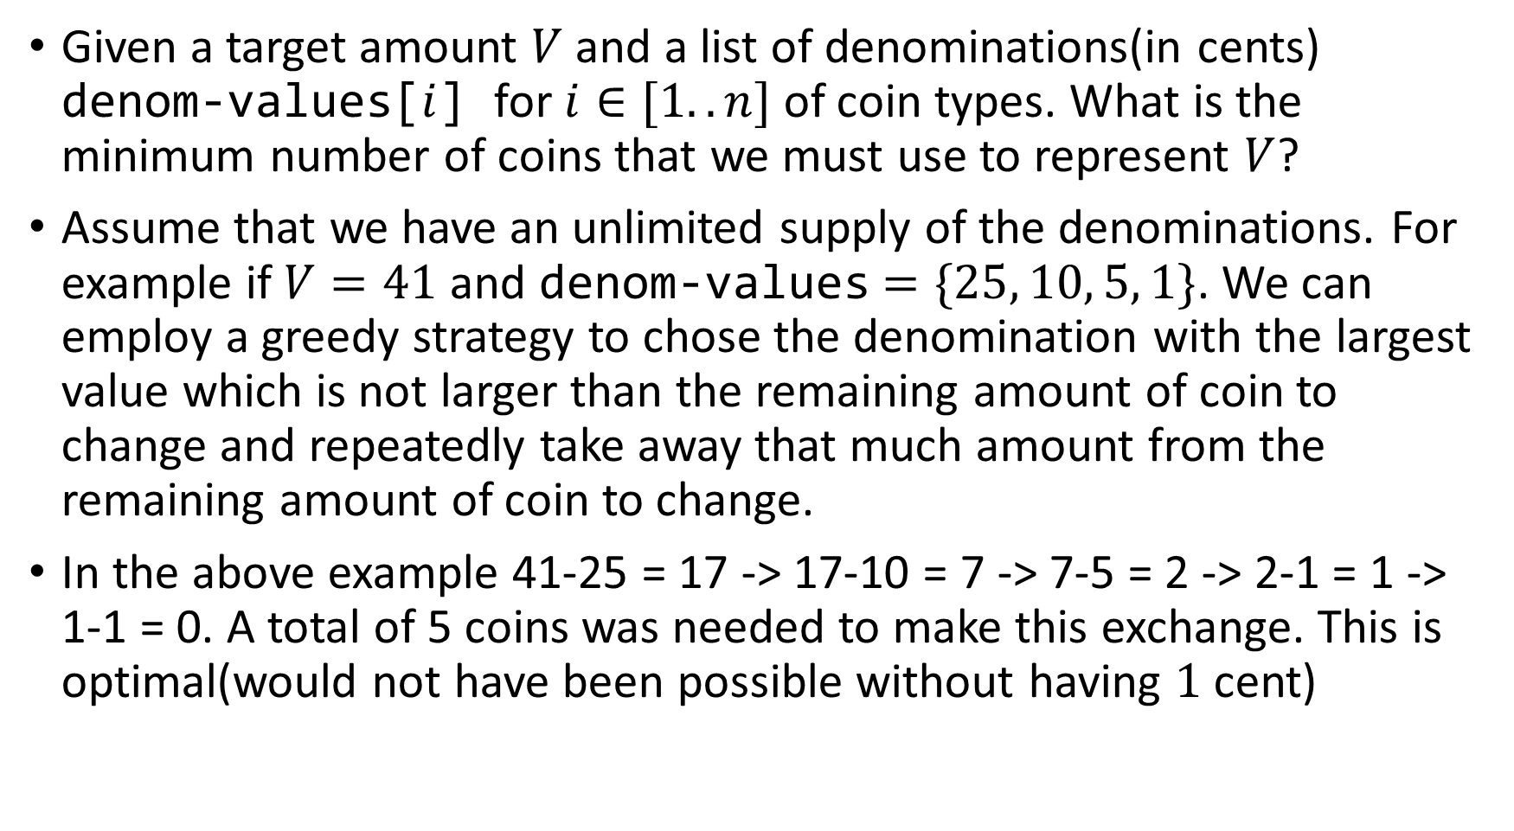
Greedy Coin Change
Given a target amount $V$ and a list of denominations(in cents) denom-values[$i$] for $i∈[1..n]$ of coin types. What is the minimum number of coins that we must use to represent $V$?
Assume that we have an unlimited supply of the denominations. For example if $V=41$and denom-values$=\{25, 10, 5, 1\}$. We can employ a greedy strategy to chose the denomination with the largest value which is not larger than the remaining amount of coin to change and repeatedly take away that much amount from the remaining amount of coin to change.
In the above example 41-25 = 17 -> 17-10 = 7 -> 7-5 = 2 -> 2-1 = 1 -> 1-1 = 0. A total of 5 coins was needed to make this exchange. This is optimal(would not have been possible without having $1$cent)

Slide 21
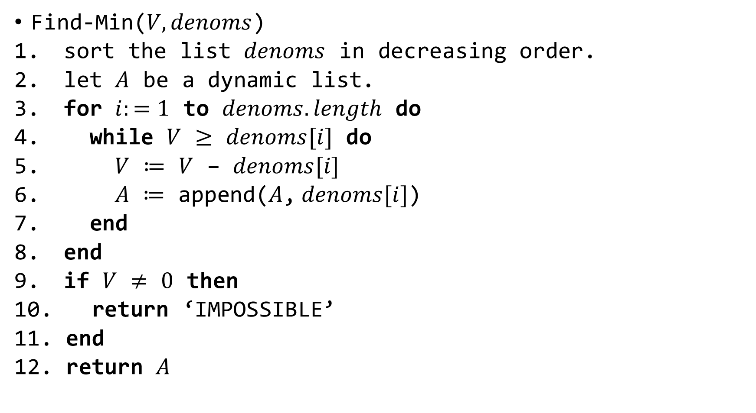
The Algorithm
Find-Min($V, denoms$)
sort the list $denoms$ in decreasing order.
let $A$ be a dynamic list.
for $i:=1$ to $denoms.length$ do
while $V$ $≥$ $denoms[i]$ do
$V$ $≔$ $V$ – $denoms[i]$
$A$ $≔$ append($A$,$denoms[i]$)
end
end
if $V$ $≠$ $0$ then
return ‘IMPOSSIBLE’
end
return $A$

Slide 22
Why The Previous Strategy Worked?
The problem had optimal sub structure: We have seen that in our quest to represent 42 cents, we used 25+10+5+1+1. This is an optimal 5-coin solution to the original problem! Optimal solutions to sub problem are contained within the 5-coin solution, i.e. To represent 17 cents, we can use 10+5+1+1 (part of the solution for 42 cents), to represent 7 cents, we can use 5+1+1 (also part of the solution for 42 cents), etc.
It has the greedy property: Given every amount V , we can greedily subtract from it the largest coin denomination which is not greater than this amount V.
But sadly this strategy does not always work. For example given {4, 3, 1}, to make a change of 6 our strategy would chose {4, 1, 1}. But the optimal solution is {3, 3}

